Slide 1
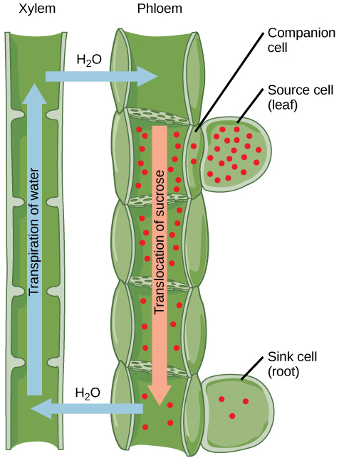
Plant Transport
Stomata and Phloem

Slide 2
Learning Goals
Explain the concept of a trade-off in terms of carbon dioxide uptake and water loss in plants
Explain how stomata open and close
Predict whether stomata will open or close, given internal or external cues

Slide 3
The carbon dioxide - water loss trade-off
Plants need to conserve water
Plants need carbon dioxide for photosynthesis
The act of gaining carbon dioxide exposes the plant to water loss
Trade-off - a balance achieved between two desirable but incompatible features

Slide 4
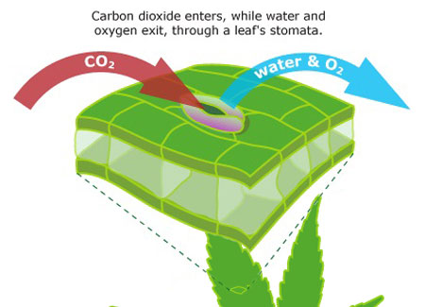
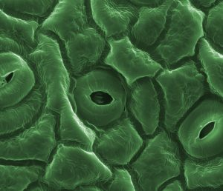
Stomata enable plants to manage this trade-off
Stomata are pores in the leaf can open and close
When open, they let carbon dioxide into the leaf
Plants lose 95% of their water through stomata

Slide 5
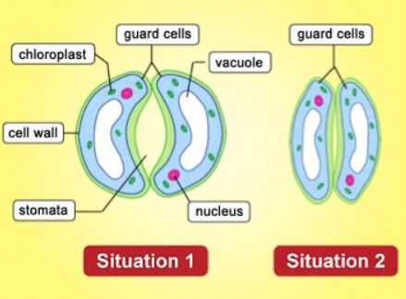
Guard cells
Each stoma (singular of stomata) is flanked by a pair of guard cells
Guard cells can change shape, effectively opening and closing stomata

Slide 6
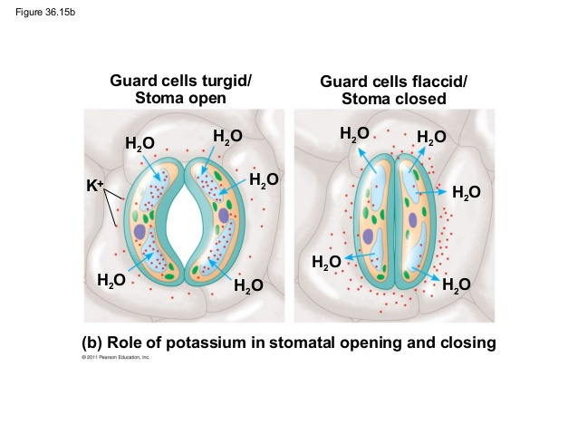
Guard cell dynamics
To open a stoma, guard cells pump K+ into the cell. This lowers water potential, causing water to enter cell.
Guard cells pump K+ out of the cell to increase water potential, causing water to leave

Slide 7
Guard cells respond to and integrate internal and external cues
Light - stimulates guard cells to accumulate K+
Low CO2 levels - stimulates guard cells to accumulate K+ if there is sufficient water in the leaf
Drought stress - plants release hormone abscisic acid in response to drought. Guard cells sense this and close
Circadian rhythm - plants have an internal clock

Slide 8
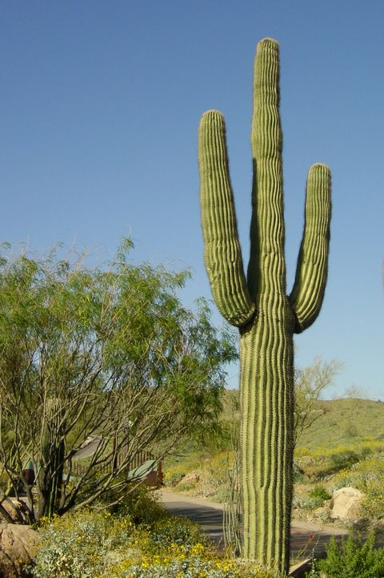
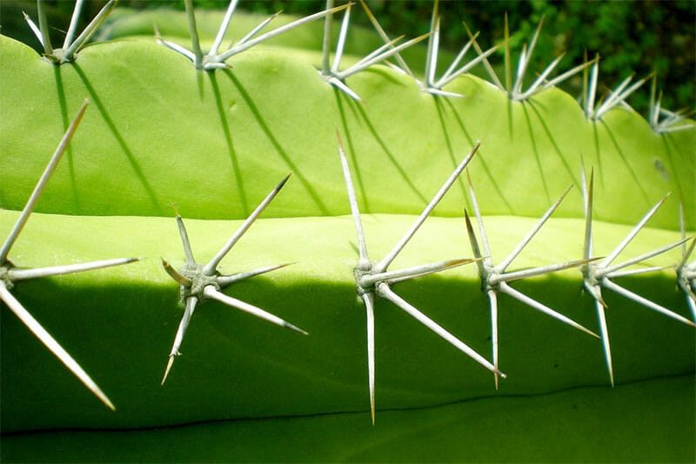
Adaptations in dry environments
Xerophyte - plant adapted to dry environment
Adaptations can include reduced leaves, photosynthetic stems, CAM photosynthesis

Slide 9
Plant Transport
Stomata and Phloem

Slide 10
Learning Goals
Describe the components of sieve tubes
Explain the concept of sources and sinks in the context of translocation

Slide 11
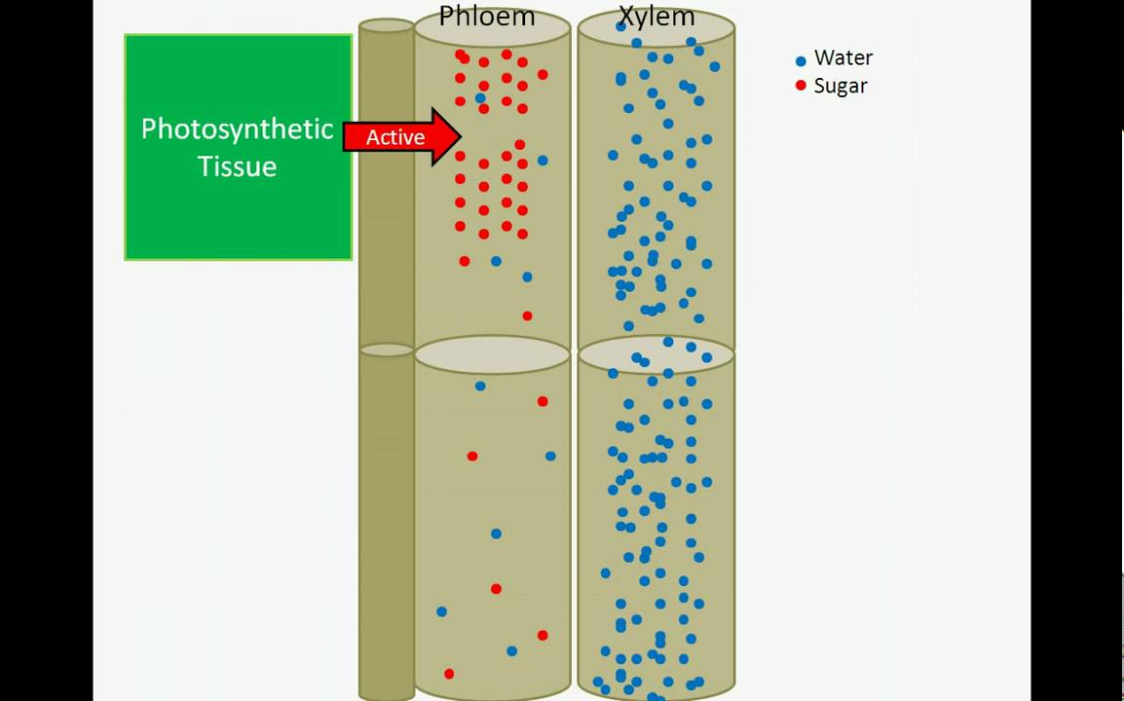
Phloem transport
Xylem sap flows from the roots through the shoot to leaves
Photosynthesis produces products that move in the opposite direction, from mature leaves to juvenile leaves, roots, meristems, etc.
Translocation is the transport of the products of photosynthesis, and it is carried out by phloem

Slide 12
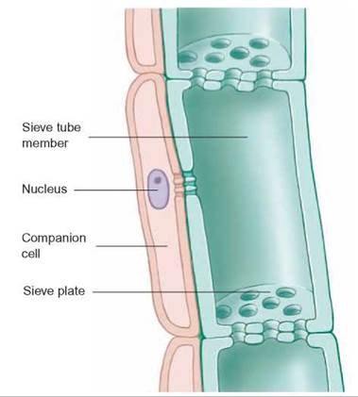
Sieve tube elements
Sieve tube elements (= sieve tube members) are specialized cells for translocation
Arranged end-to-end, form sieve tubes
Between sieve tube elements are sieve plates

Slide 13
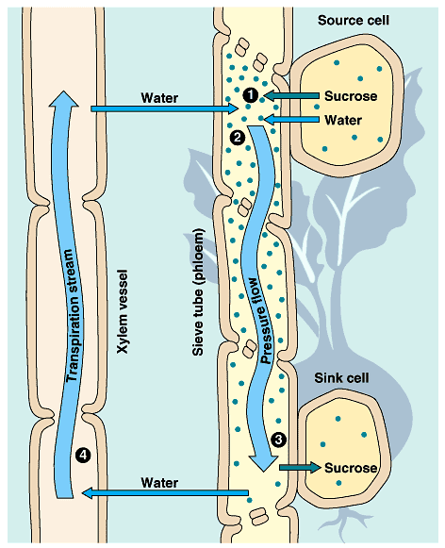
Phloem sap moves form sugar sources to sugar sinks
Source- organ or tissues that are a net producer of sugar through photosynthesis or starch metabolism
Sink - organ or tissue that is a net consumer of sugars, such as growing roots, buds, stems, fruits

Slide 14
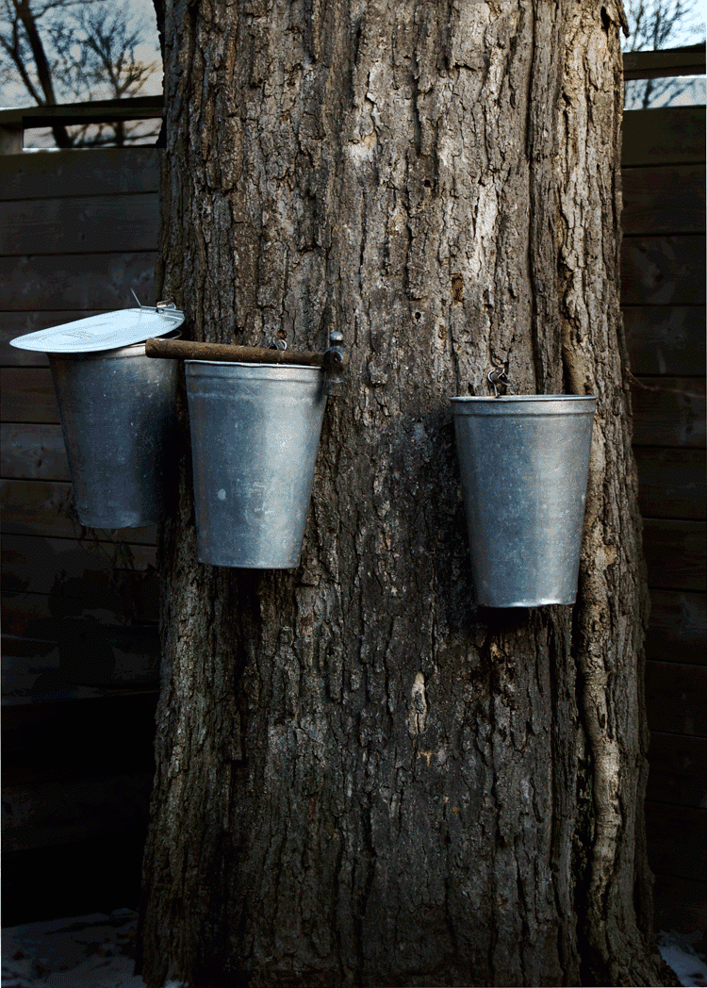
Organs and tissues can switch between being sources and sinks
Newly expanding leaves are sinks, but they become sources when they mature
Storage organs can be sinks during the growing season, but become sources near the end of the dormant season as they provide energy for breaking dormancy

Slide 15
Plant Transport
Stomata and Phloem

Slide 16
Learning Goals
Explain the mechanisms of symplastic and apoplastic sugar loading
Identify the force that drives phloem flow

Slide 17
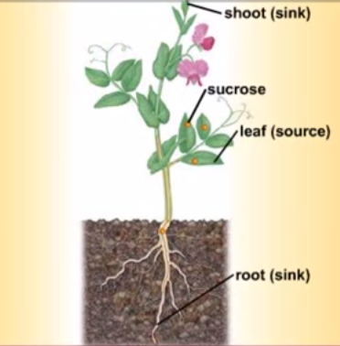
Source-sink transport dynamics
Sinks usually receive sugars from the nearest source
For each sieve tube, direction of phloem sap transport depends on its position relative to source and sink

Slide 18
Sugar loading at sources
Sugars need to be loaded into sieve tubes before they can be transported
Can move from leaf mesophyll cells through the apoplastic or symplastic pathways

Slide 19
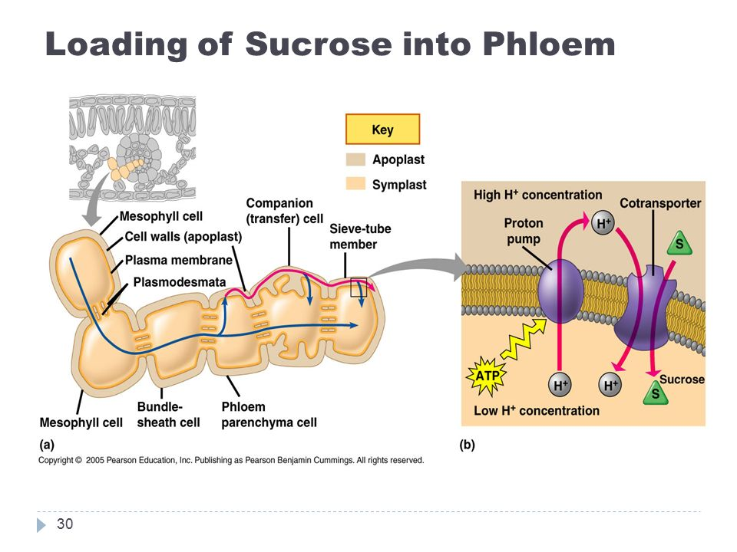

Slide 20
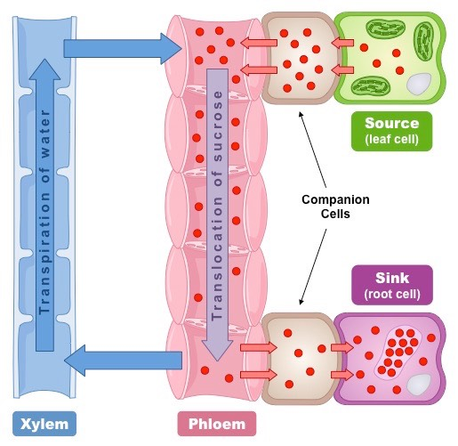
Sugar unloading at sinks
Sugars are unloaded at the sink end of a sieve tube
Sink tissues or organs consume sugar during growth and metabolism

Slide 21
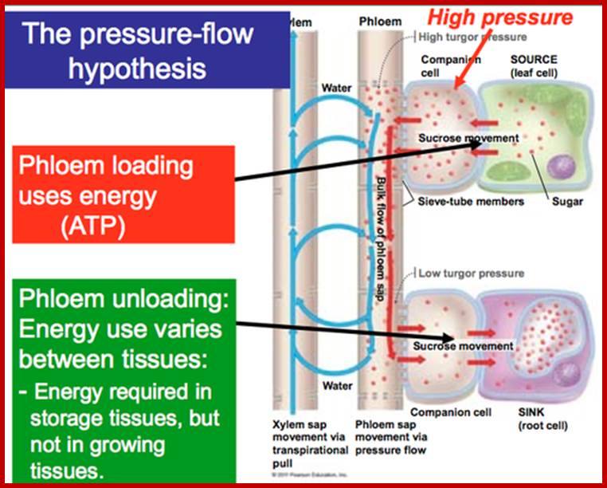
Positive pressure drives the flow of phloem sap
Flows from sources to sinks at rates of 1 m per hour
Driven by pressure flow
Higher pressure in source cells than in the sink cells

Slide 22
Plant Transport
Stomata and Phloem

Slide 23
Learning Goals
Identify functions of the symplast not related to the transport of water, sugar, or minerals

Slide 24
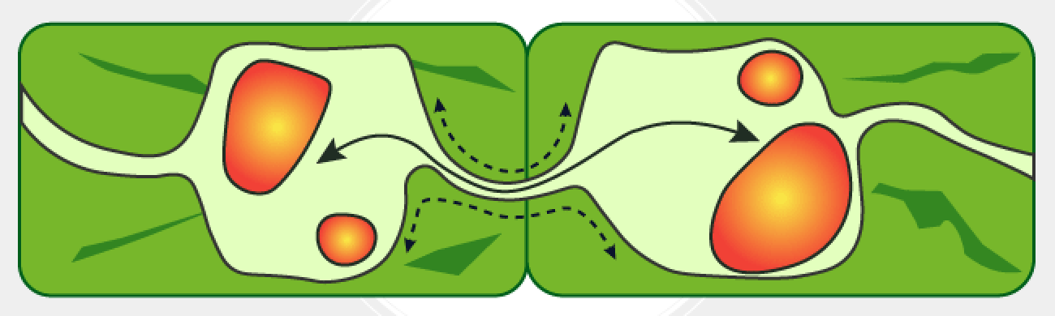
The symplast is dynamic
Symplast is the part of the cell inside the plasma membrane, and includes the connections between cells

Slide 25
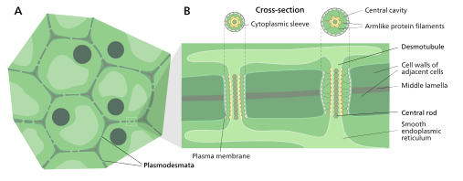
Dynamics of plasmodesmata
Can open or close in response to turgor pressure, Ca++ concentration, pH
Can be eliminated over the course of cell development
Size can be manipulated by viruses

Slide 26
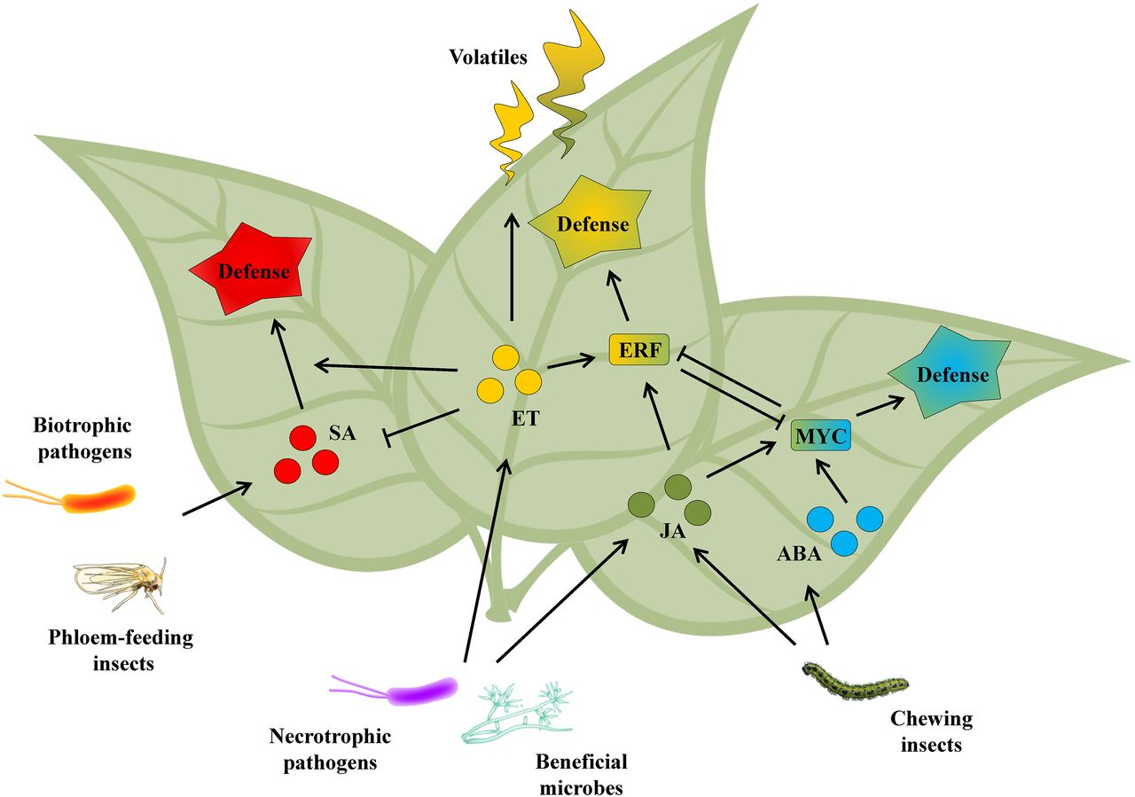
Information transfer
Hormones produced in leaves travel can through phloem and induce flowering in meristems
Localized damage to plants can send signals through phloem to activate defense genes in neighboring cells

Slide 27
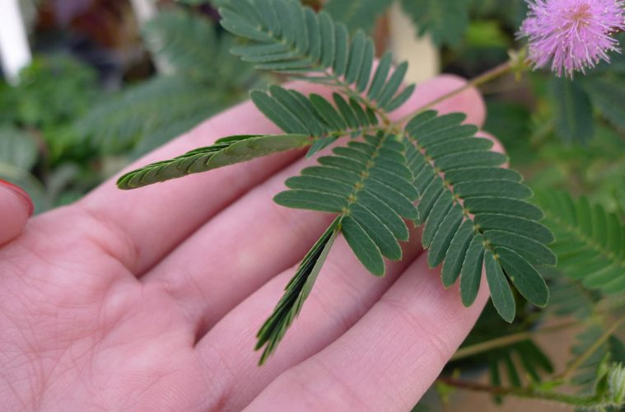
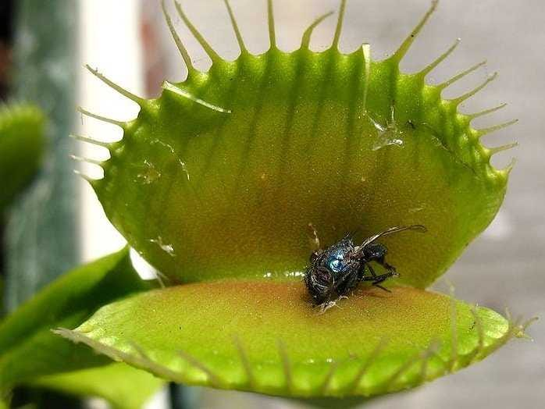
Electrical signaling
Long-distance electrical signals travel through phloem
Generate rapid leaf movements in sensitive plant, Venus flytrap

